Slide 1

Federated Learning
and
Smart Contracts
Mihoubi Nahla Yasmine

Slide 2
Table of contents
01
02
03
04
05
06
Objectives
FDL
Smart contract
Project
Demo
Conclusion

Slide 3

01
Introduction
Notes:
Data privacy and security risks
Trust and transparency issues
Secure participant contribution and consent
How blockchain and smart contracts can address these challenges
Slide 5: Introduction to Blockchain and Smart Contracts
Blockchain: A decentralized ledger technology ensuring transparency and security.
Smart Contracts: Self-executing contracts that automate agreements without intermediaries.
Benefits:
Immutable and tamper-proof
Automated execution of rules
Transparent consent management
Slide 6: Integration of Federated Learning with Smart Contracts
How It Works:
Participants register and give consent via smart contracts.
FL models train on local devices without exposing data.
Results are aggregated securely.
Smart contracts ensure compliance and prevent unauthorized contributions.
Slide 7: Implementation Details
Tools Used:
Federated Learning: Google Colab, PySyft/TensorFlow Federated
Blockchain: Remix, MetaMask, Ganache, Web3.py
Smart Contract Role:
Manages participant consent
Automates reward mechanisms
Ensures model integrity
Slide 8: Demo/Code Overview
Show a snippet of the smart contract code
Explain how Web3.py interacts with the contract
Demonstrate how a user registers and submits training results securely
Slide 9: Benefits of This Approach
Enhanced data privacy and security
Decentralized control and trust
Transparent and auditable AI training
Scalable for real-world applications (healthcare, finance, etc.)
Slide 10: Future Improvements and Research Directions
Implementing Zero-Knowledge Proofs (ZKPs) for additional security
Enhancing scalability for large networks
Exploring other blockchain solutions beyond Ethereum (e.g., Hyperledger)
Slide 11: Conclusion
Recap of key points
Importance of privacy-preserving AI
How federated learning and blockchain create a secure AI ecosystem
Thank You!
Slide 12: Q&A
Open the floor for questions and discussions

Slide 4

Objective
To predict Polycystic Ovary Syndrome (PCOS) using Vertical Federated Learning (VFL) and Horizontal Federated Learning (HFL)
To ensure privacy and consent management using smart contracts Vertical Federated Learning (VFL)
Notes:
Learning
Data privacy and security risks
Trust and transparency issues
Secure participant contribution and consent
How blockchain and smart contracts can address these challenges
Slide 5: Introduction to Blockchain and Smart Contracts
Blockchain: A decentralized ledger technology ensuring transparency and security.
Smart Contracts: Self-executing contracts that automate agreements without intermediaries.
Benefits:
Immutable and tamper-proof
Automated execution of rules
Transparent consent management
Slide 6: Integration of Federated Learning with Smart Contracts
How It Works:
Participants register and give consent via smart contracts.
FL models train on local devices without exposing data.
Results are aggregated securely.
Smart contracts ensure compliance and prevent unauthorized contributions.
Slide 7: Implementation Details
Tools Used:
Federated Learning: Google Colab, PySyft/TensorFlow Federated
Blockchain: Remix, MetaMask, Ganache, Web3.py
Smart Contract Role:
Manages participant consent
Automates reward mechanisms
Ensures model integrity
Slide 8: Demo/Code Overview
Show a snippet of the smart contract code
Explain how Web3.py interacts with the contract
Demonstrate how a user registers and submits training results securely
Slide 9: Benefits of This Approach
Enhanced data privacy and security
Decentralized control and trust
Transparent and auditable AI training
Scalable for real-world applications (healthcare, finance, etc.)
Slide 10: Future Improvements and Research Directions
Implementing Zero-Knowledge Proofs (ZKPs) for additional security
Enhancing scalability for large networks
Exploring other blockchain solutions beyond Ethereum (e.g., Hyperledger)
Slide 11: Conclusion
Recap of key points
Importance of privacy-preserving AI
How federated learning and blockchain create a secure AI ecosystem
Thank You!
Slide 12: Q&A
Open the floor for questions and discussions

Slide 5

Polycystic Ovary Syndrome (PCOS)
What is PCOS ?
A hormonal disorder common among women of reproductive age ==>Causes irregular periods, excessive androgen levels, and ovarian cysts.
Normal Ovary
Polycystic Ovary

Slide 6


Why Study PCOS Using Federated Learning?
Challenges in PCOS Research:
Sensitive medical data that requires privacy
Need for collaboration between hospitals and research institutions without sharing raw patient data.
Solution:
Federated Learning (FL)

Slide 7
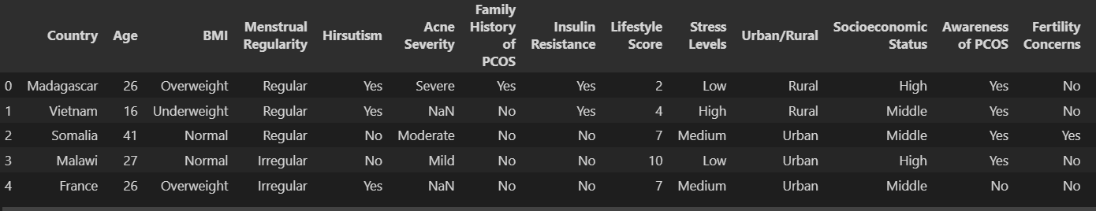
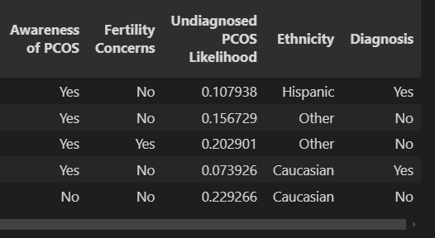
Data Used in the Study?

Slide 8

02
Federated Learning

Slide 9

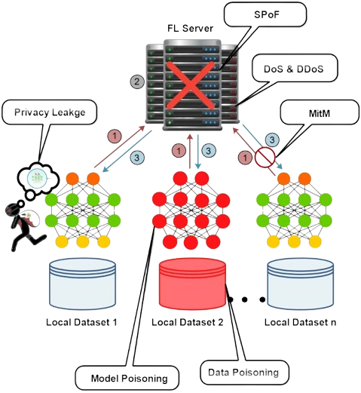
Federated Learning
is a decentralized approach to machine learning where multiple participants collaboratively train a model without sharing data..
Why It Matters
Regulatory Compliance
Collaborative Model Improvement
Data Privacy Protection
Reduced Data Transfer Costs

Slide 10
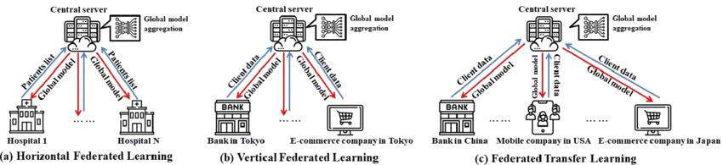
Types of Federated Learning
Horizontal
Vertical
Transfer
-Same feature space,different sample sets
Same samples, different feature spaces
-integrate both HFDL and VFDL, utilizing transfer

Slide 11
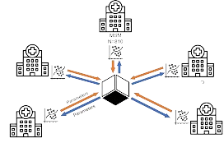
In my case (HFL)
Horizontal
Different countries sharing PCOS prediction features
Vietnam
Algeria
France
Japan
…

Slide 12
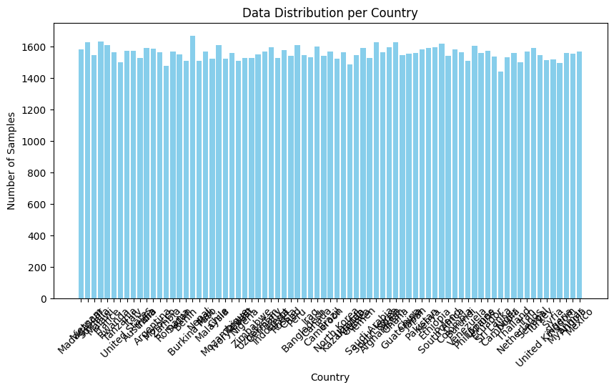
In my case (HFL)
Federated Averaging (FedAvg).
Type
1479 (Zambia) to 1667 (Burkina Faso).
Notes:
Data Distribution per Country
Madagascar: 1581 samples
Vietnam: 1626 samples
Somalia: 1545 samples
Malawi: 1632 samples
France: 1609 samples
Rwanda: 1563 samples
Tanzania: 1501 samples
United States: 1574 samples
Italy: 1574 samples
Australia: 1526 samples
India: 1590 samples
Argentina: 1587 samples
Morocco: 1565 samples
Zambia: 1479 samples
Romania: 1567 samples
Sudan: 1552 samples
Benin: 1509 samples
Burkina Faso: 1667 samples
Nepal: 1509 samples
Mali: 1570 samples
Malaysia: 1522 samples
Chile: 1609 samples
Mozambique: 1523 samples
Ivory Coast: 1560 samples
Taiwan: 1510 samples
Nigeria: 1528 samples
Zimbabwe: 1528 samples
Uzbekistan: 1549 samples
Germany: 1571 samples
Indonesia: 1596 samples
Egypt: 1530 samples
Russia: 1577 samples
Chad: 1541 samples
Peru: 1608 samples
Bangladesh: 1544 samples
Iraq: 1532 samples
Canada: 1602 samples
Cameroon: 1543 samples
Brazil: 1569 samples
North Korea: 1523 samples
Kazakhstan: 1562 samples
Uganda: 1487 samples
Guinea: 1547 samples
Yemen: 1593 samples
Saudi Arabia: 1529 samples
South Korea: 1626 samples
Afghanistan: 1566 samples
Spain: 1598 samples
Ghana: 1629 samples
Guatemala: 1547 samples
China: 1554 samples
Japan: 1560 samples
Pakistan: 1581 samples
Kenya: 1591 samples
Ethiopia: 1598 samples
South Africa: 1619 samples
Poland: 1540 samples
Colombia: 1583 samples
Burundi: 1565 samples
Venezuela: 1508 samples
Philippines: 1607 samples
Ukraine: 1560 samples
Ecuador: 1572 samples
Sri Lanka: 1535 samples
Cambodia: 1441 samples
Niger: 1534 samples
Thailand: 1560 samples
Netherlands: 1500 samples
Iran: 1570 samples
Senegal: 1592 samples
Turkey: 1546 samples
United Kingdom: 1514 samples
Syria: 1517 samples
Algeria: 1496 samples
Myanmar: 1559 samples
Angola: 1553 samples
Mexico: 1570 samples

Slide 13



In my case (VFL)
Medical center + Demographics center
Party A (Medical Center):
Menstrual Regularity
Hirsutism
Acne Severity
Family History
Insulin Resistance
BMI Categories
Party B (Demographics):
Lifestyle Score
Stress Levels
Urban/Rural
Socioeconomic Status
Ethnicity Categories

Slide 14

Result
VFL
Global Model:
Training Accuracy: 47.33%
Test Accuracy: 47.13%
ROC-AUC: 0.4915
Party-Specific:
Medical Center: 59.47%
Demographics Center: 57.04%
HFL
Final Round Accuracies:
Best: malawi (90.69%)
Average: ~0.89%
Lowest: Kenya (87.81%)

Slide 15
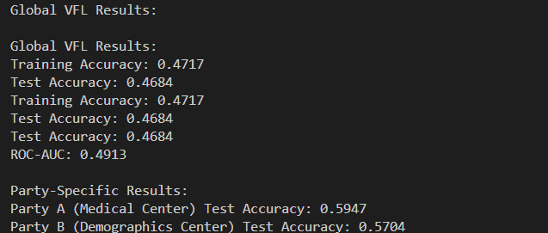
Result
VFL
Global Model:
Training Accuracy: 47.33%
Test Accuracy: 47.13%
ROC-AUC: 0.4915
Party-Specific:
Medical Center: 59.47%
Demographics Center: 57.04%

Slide 16
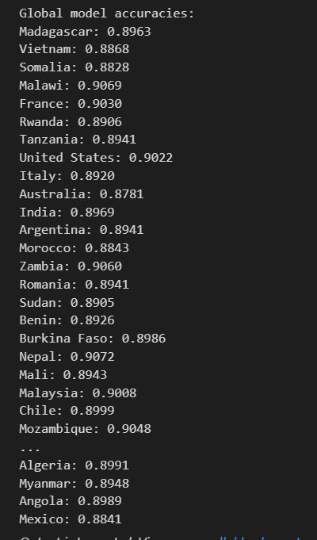
Result
HFL
Final Round Accuracies:
Best: Nepal(90.72% )
Average: ~0.89%
Lowest: Australia(87.81% )

Slide 17
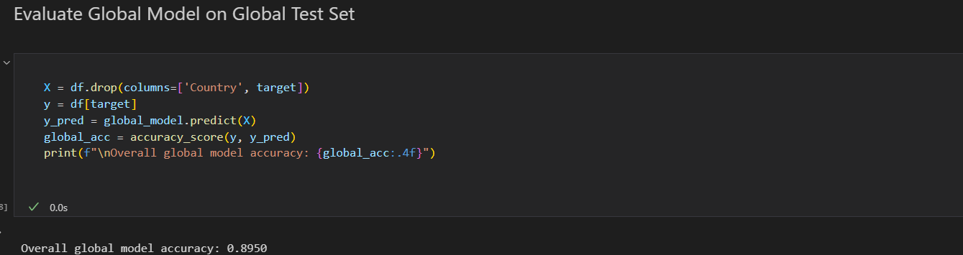
Result
Evaluate Global model on global test set (drop country )
Result: 89.50%

Slide 18
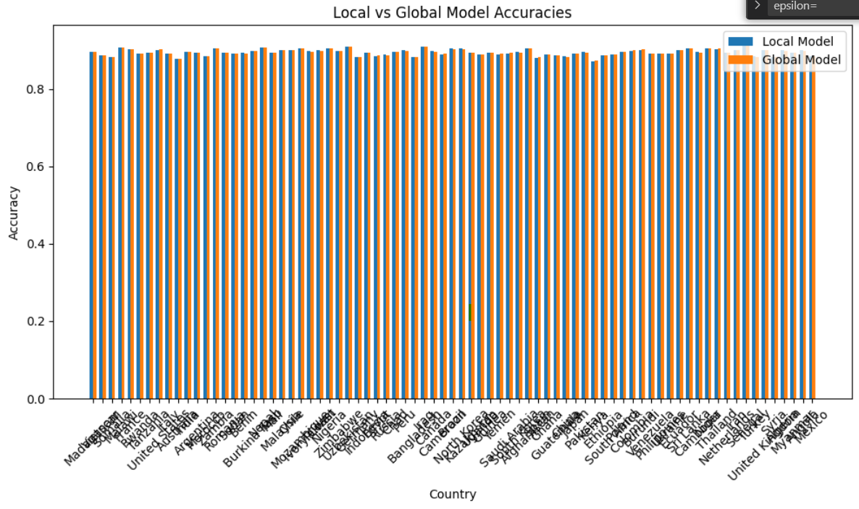
Result

Slide 19

03
Smart Contract

Slide 20
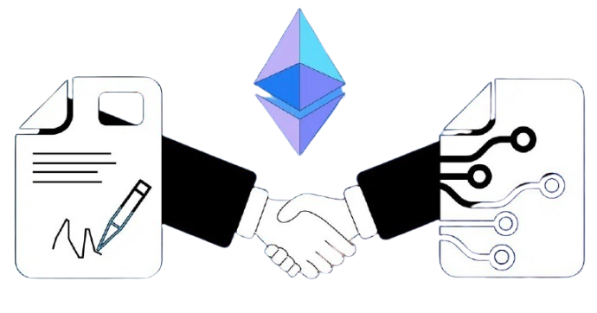

Smart Contract
What is a Smart Contract?
A Smart Contract is a self-executing program stored on a blockchain that automatically enforces the terms of an agreement when predefined conditions are met. It eliminates intermediaries, ensuring secure, transparent, and trustless transactions.

Slide 21
Smart Contract
Why Combine FL with Smart Contracts?
Enhances security and trust in collaborative AI models.
Ensures transparency in model updates and rewards participants fairly.
Why Use Blockchain and Web3 for FL?
Challenges in FL Without Blockchain:
Risk of malicious updates (model poisoning attacks).
Lack of trust in the central aggregator.
No incentive mechanism for honest participation.
How Blockchain Solves These Issues:
Smart contracts validate and store model updates securely.
Decentralized network prevents a single point of failure.
Participants are rewarded using cryptocurrency/tokens for valid contributions.
Notes:
.

Slide 22

04
Project Overview

Slide 23



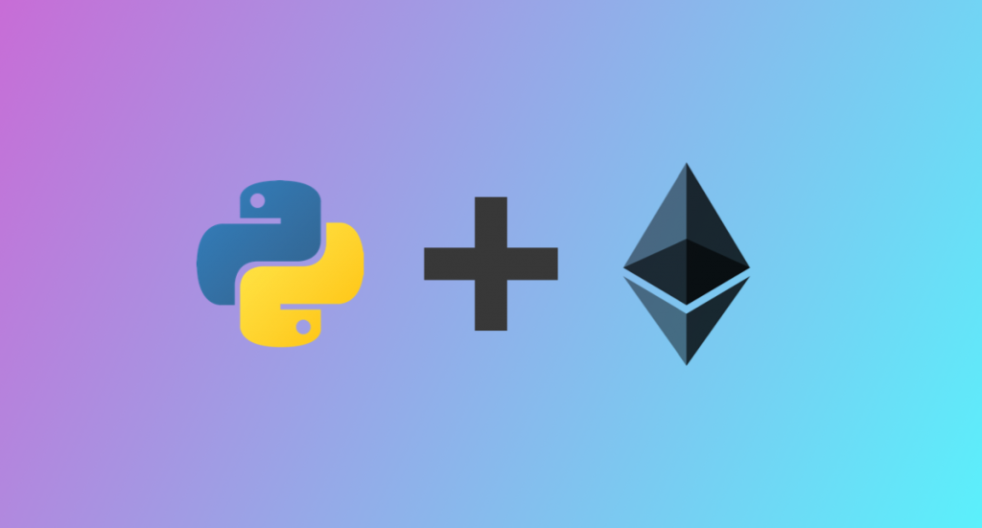
Development Tools
Remix
Ganache
web3.py
Metamask

Slide 24
Technical Architecture
VFL Coordinator
Smart Contract
Web3 Interface
Feature Management
Model Training
Results Aggregation
Consent Management
Access Control
Event Logging
Blockchain Communication
Transaction Management
Status Verification

Slide 25
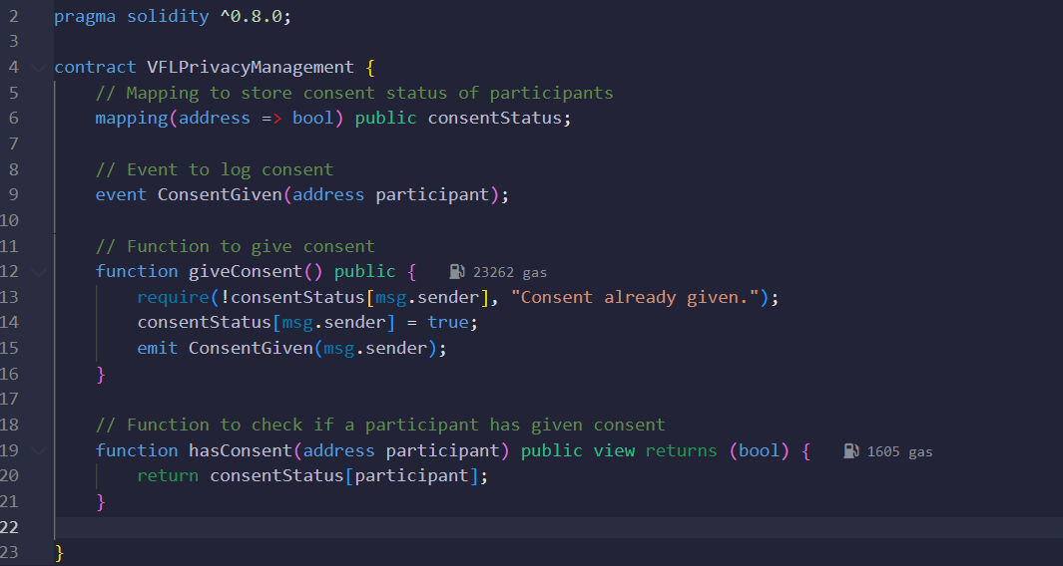
Smart Contract Integration

Slide 26
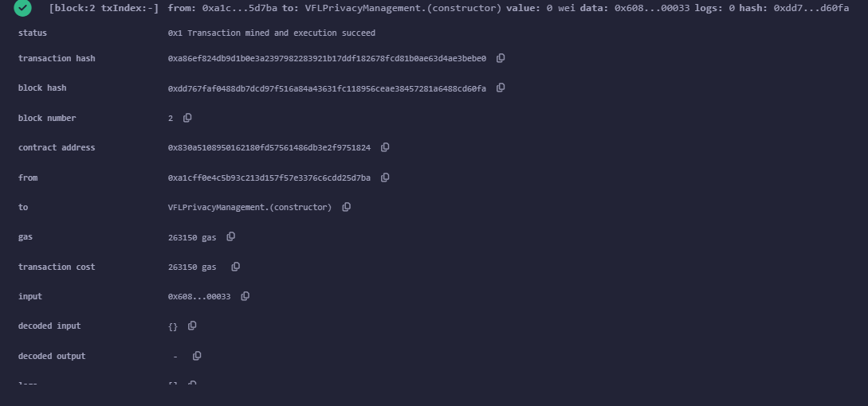
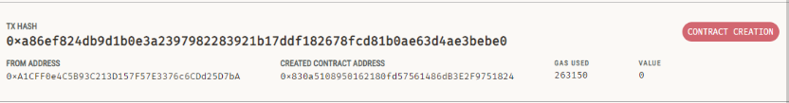
Smart Contract Integration

Slide 27
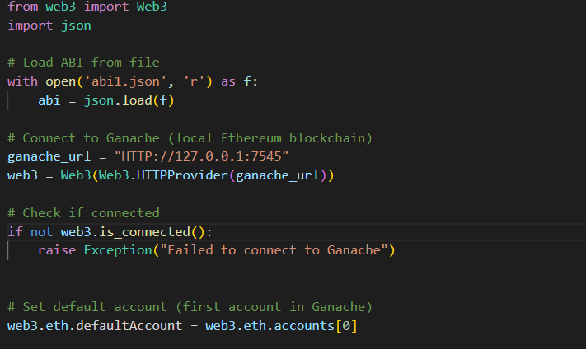
Web3
This is only the connection ganche Ganache and the smart contract (using ABI.json )
The rest of the code you find it in folder

Slide 28
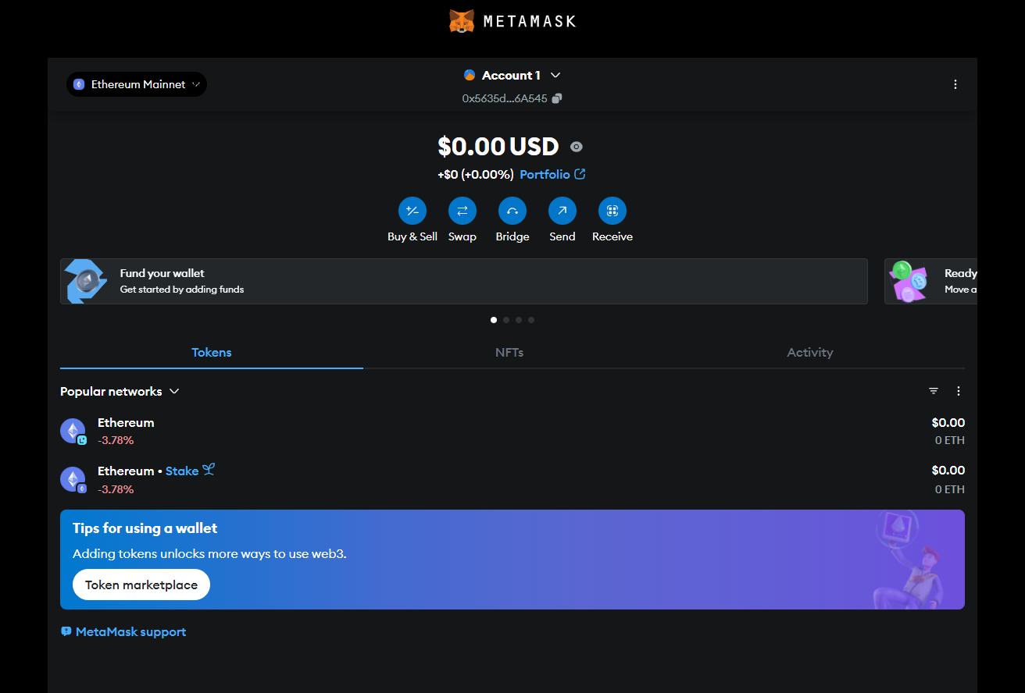
Smart Contract Integration

Slide 29
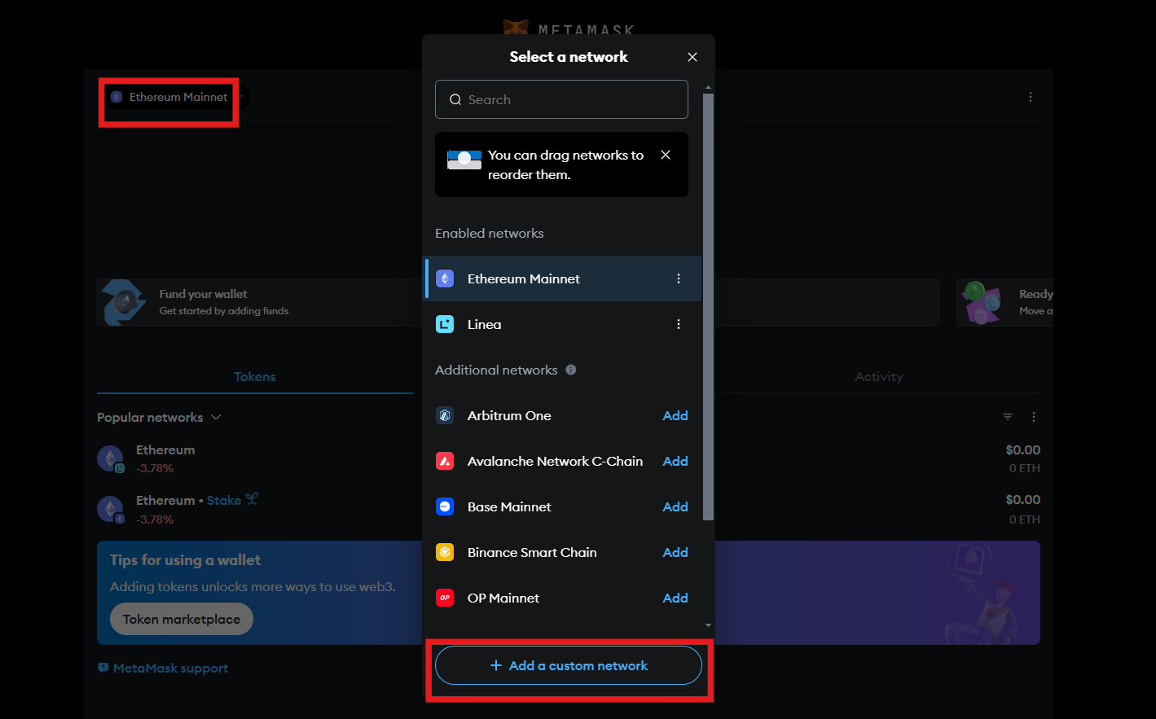
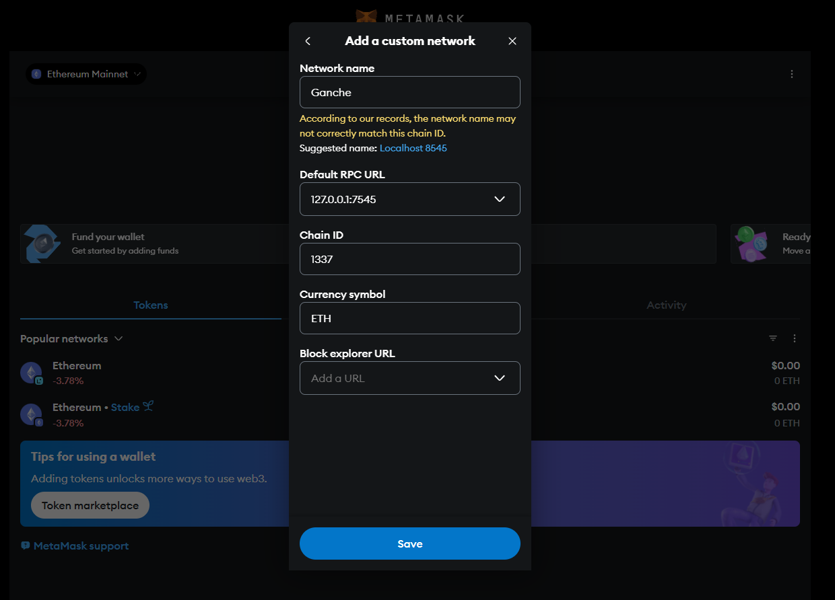
Metamask
Connect gGanache and MetaMask by adding network .

Slide 30
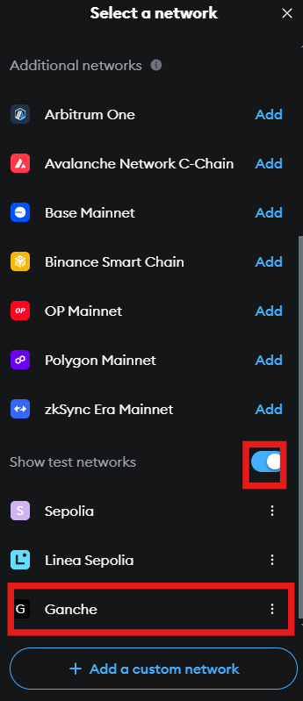
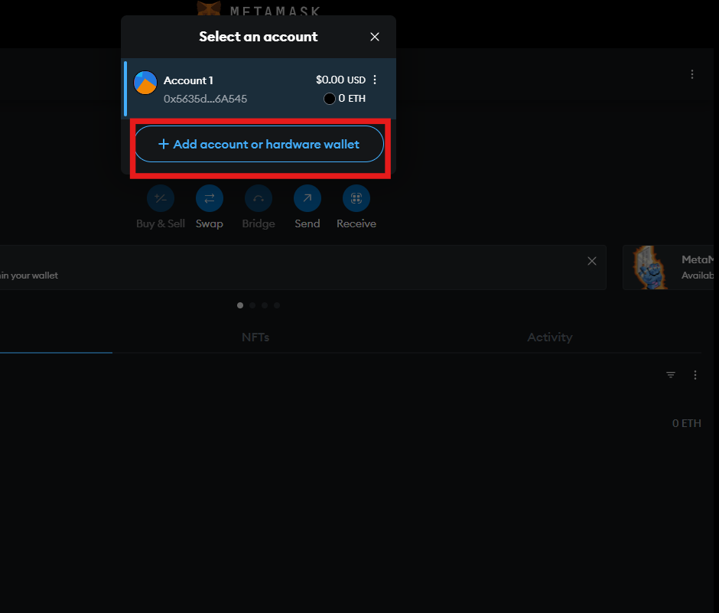
Metamask
Add account (that Ganache has in MetaMask)

Slide 31
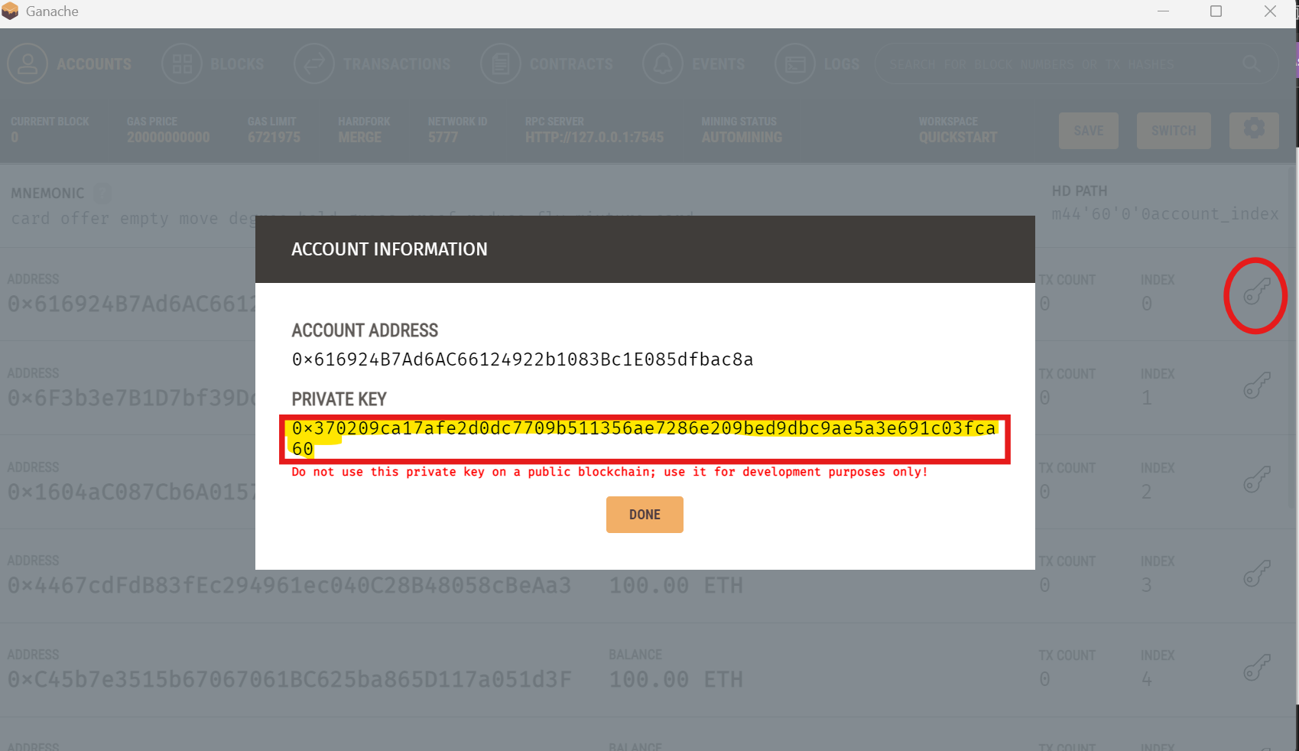
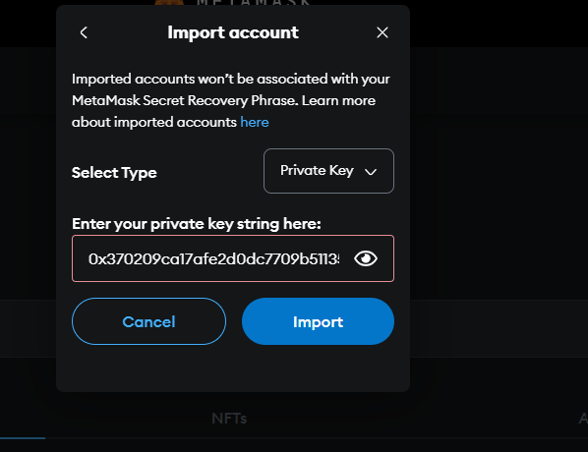
Add the account that Ganache has in MetaMask

Slide 32
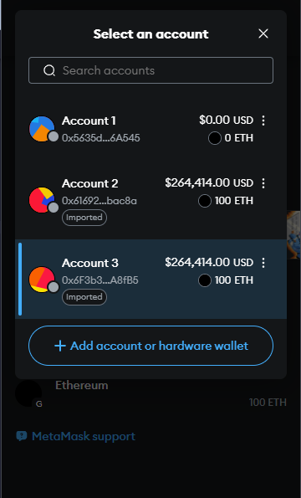
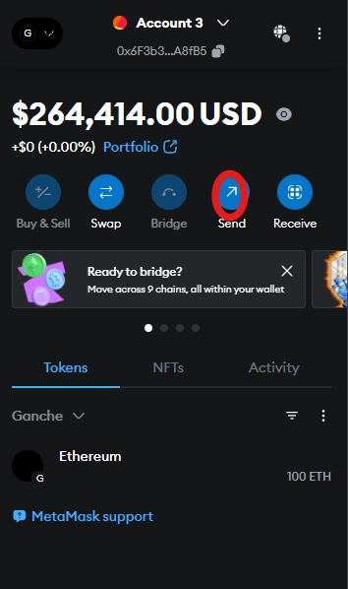
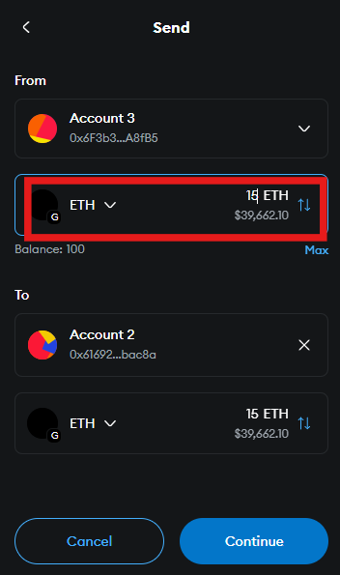
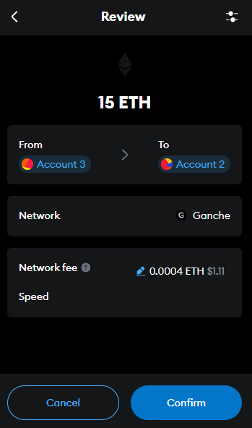
Transferbetween between accounts using Metamask

Slide 33
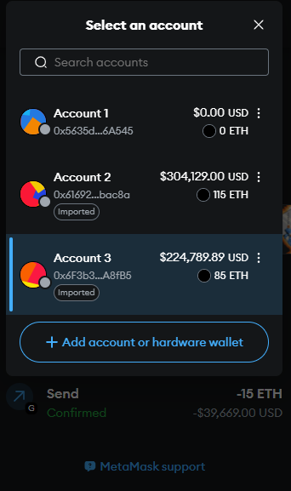
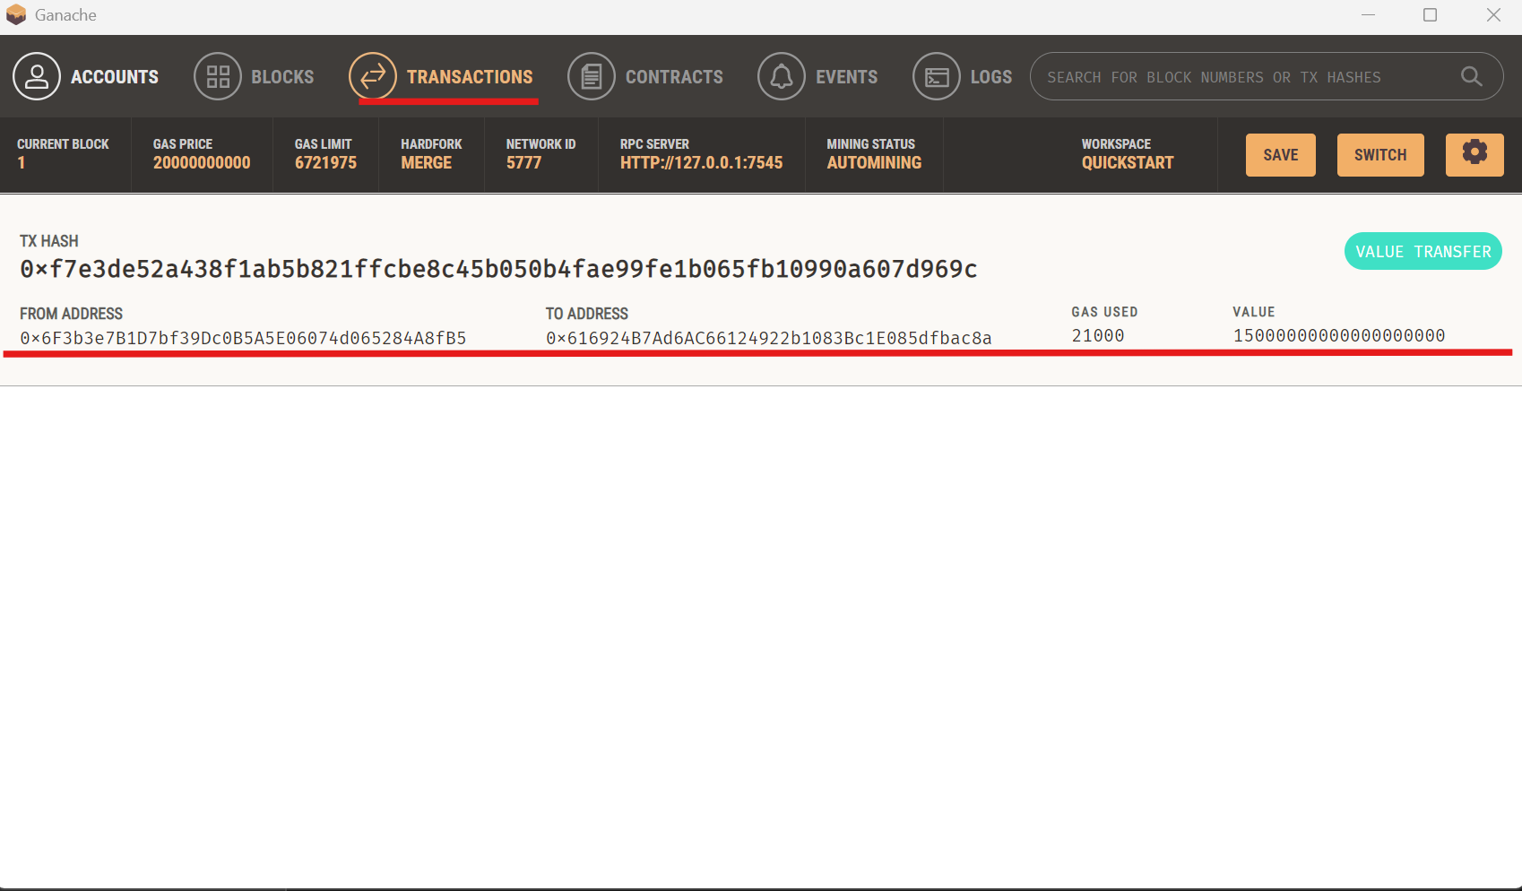
Transaction valide.

Slide 34
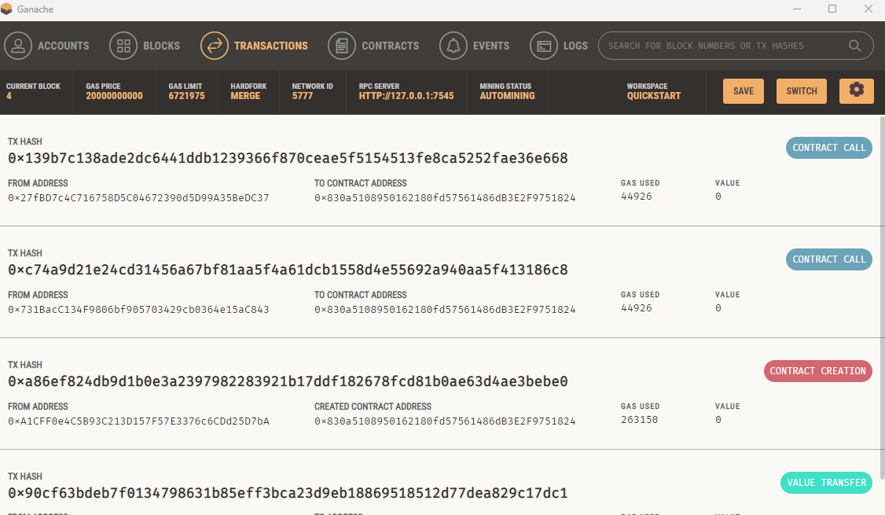

Slide 35
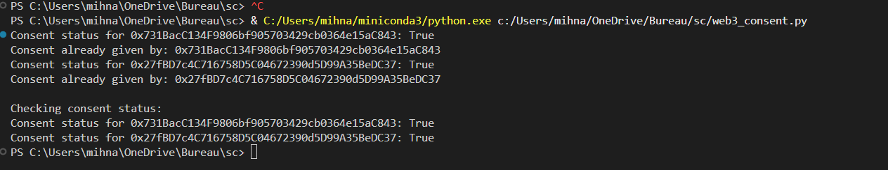
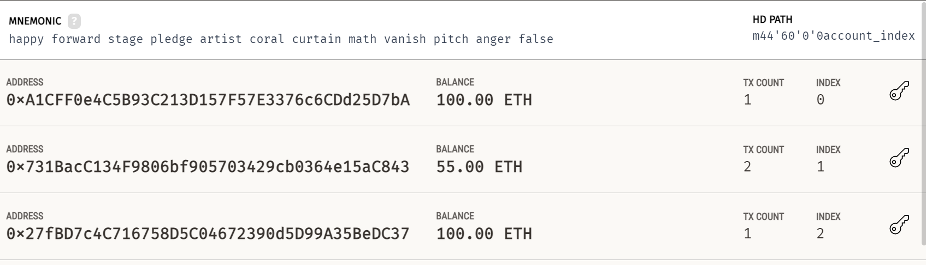

Slide 36
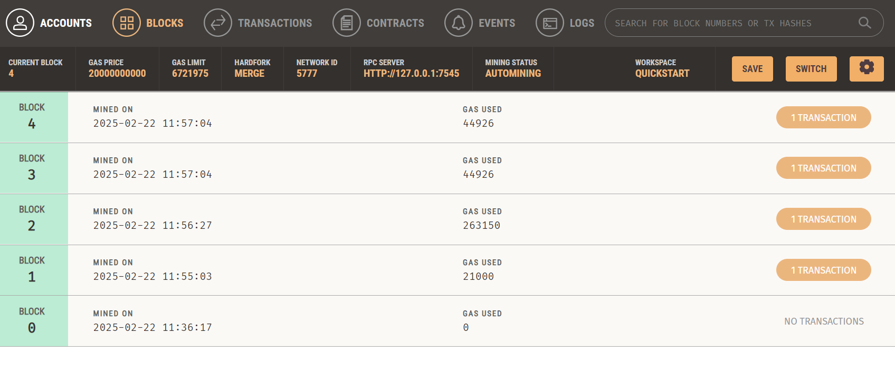

Slide 37
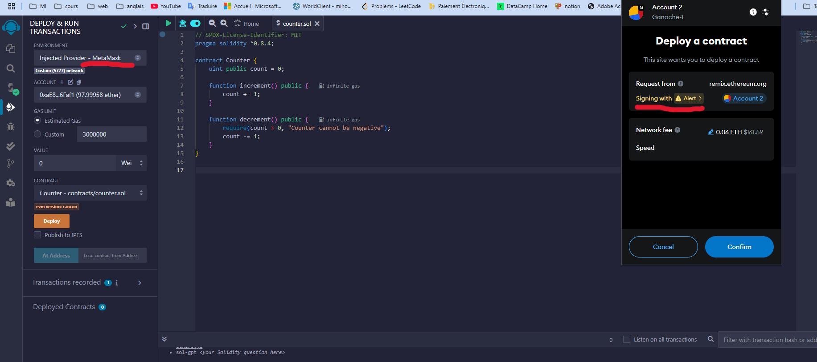
Its jut like note when i use fist time the metamask i was have error of gas limit after that i change the cost of gas in parameters of metamsk to make every thing work correctly
-this slid to see alert and error even with sample contract

Slide 38

Thanks!

